Slide 1
MA
1). Asset Allocation - Current Allocation (Table)
Description: This object displays the overall asset allocation of the portfolio. The actual asset classes defined in your data will be displayed.
Settings:
Setting Name: Sort by
Type: dropdown
Values (for drop downs): default asset class order; asset class value, ascending; asset class value, descending
Default Value: default asset class order
Help Text:
Number Formatting
**Decimal places on all columns: Default for MVs – zero decimals; Default for % - 2 decimals.
**currency formatting on currency fields
<Asset Allocation>
Asset Class |  | Value | Percent of Portfolio
 | <asset class> | <$nn,nnn,nnn> | <nn.nn%>
 | <asset class> | <$nn,nnn,nnn> | <nn.nn%>
 | <asset class> | <$nn,nnn,nnn> | <nn.nn%>
 | <asset class> | <$nn,nnn,nnn> | <nn.nn%>
 | <asset class> | <$nn,nnn,nnn> | <nn.nn%>
 | TOTAL | <$nn,nnn,nnn> | <nn.nn%>

Slide 2
MA
2). Asset Allocation - Current Allocation with Accrued Income Separated (Table)
Description: This object displays the overall asset allocation with accrued income as a separate line. The actual asset classes defined in your data will be displayed.
Settings:
Setting Name: Sort by
Type: dropdown
Values (for drop downs): default asset class order; asset class value, ascending; asset class value, descending
Default Value: default asset class order
Help Text:
Number Formatting
**Decimal places on all columns: Default for MVs – zero decimals; Default for % - 2 decimals.
**currency formatting on currency fields
Notes:
** This object is NOT sensitive to AI configuration at Issue Level.
<Asset Allocation>
Asset Class |  | Value | Percent of Portfolio
 | <asset class> | <$nn,nnn,nnn> | <nn.nn%>
 | <asset class> | <$nn,nnn,nnn> | <nn.nn%>
 | <asset class> | <$nn,nnn,nnn> | <nn.nn%>
 | <asset class> | <$nn,nnn,nnn> | <nn.nn%>
 | <asset class> | <$nn,nnn,nnn> | <nn.nn%>
 | TOTAL | <$nn,nnn,nnn> | <nn.nn%>
 | Accrued Income | <$nn,nnn,nnn>
 | Total with Accrued Income | <$nn,nnn,nnn>

Slide 3
MA
3). Asset Allocation - Current Allocation with Yield (Table)
Description: This object displays the overall asset allocation and yield for each asset class. The actual asset classes defined in your data will be displayed.
Settings:
Setting Name: Sort by
Type: dropdown
Values (for drop downs): default asset class order; asset class value, ascending; asset class value, descending
Default Value: default asset class order
Help Text:
Number Formatting
**Decimal places on all columns: Default for MVs – zero decimals; Default for % - 2 decimals.
**currency formatting on currency fields
<Asset Allocation>
Asset Class |  | Value | Percent of Portfolio | Yield
 | <asset class> | <$nn,nnn,nnn> | <nn.nn%> | <nn.nn%>
 | <asset class> | <$nn,nnn,nnn> | <nn.nn%> | <nn.nn%>
 | <asset class> | <$nn,nnn,nnn> | <nn.nn%> | <nn.nn%>
 | <asset class> | <$nn,nnn,nnn> | <nn.nn%> | <nn.nn%>
 | <asset class> | <$nn,nnn,nnn> | <nn.nn%> | <nn.nn%>
 | TOTAL | <$nn,nnn,nnn> | <nn.nn%> | <nn.nn%>

Slide 4
MA
4). Asset Allocation - Current and Target Allocation (Table)
Description: This object displays the overall asset allocation of the portfolio along with the target allocation. The target allocation may be a range or numeric value. The actual asset classes defined in your data will be displayed. **Please note: Target data must be sent to Assette.
<Asset Allocation>
Asset Class |  | Value | Percent of Portfolio | Target Percent | Difference
 | <asset class> | <$nn,nnn,nnn> | <nn.nn%> | <nn.nn%> | <nn.nn%>
 | <asset class> | <$nn,nnn,nnn> | <nn.nn%> | <nn.nn%> | <nn.nn%>
 | <asset class> | <$nn,nnn,nnn> | <nn.nn%> | <nn.nn%> | <nn.nn%>
 | <asset class> | <$nn,nnn,nnn> | <nn.nn%> | <nn.nn%> | <nn.nn%>
 | <asset class> | <$nn,nnn,nnn> | <nn.nn%> | <nn.nn%> | <nn.nn%>
 | TOTAL | <$nn,nnn,nnn> | <nn.nn%>
Settings:
Setting Name: Show Difference
Type: dropdown
Values (for drop downs): yes; no
Default Value: yes
Help Text: If the Target Percent values are ranges, then the Difference column will show “-” (dashes).
Setting Name: Sort by
Type: dropdown
Values (for drop downs): default asset class order; asset class value, ascending; asset class value, descending
Default Value: default asset class order
Help Text:
Number Formatting
**Decimal places on all columns: Default for MVs – zero decimals; Default for % - 2 decimals.
**currency formatting on currency fields
Notes:
** If there is no target, display a dash in row.

Slide 5
MA
5). Asset Allocation - Comparison with Prior Period (Table)
Description: This object displays the current asset allocation of the portfolio along with the allocation for a prior period you select. The actual asset classes defined in your data will be displayed.
Settings:
Setting Name: Prior period
Type: dropdown
Values (for drop downs): prior month-end; prior quarter-end; prior year-end; 12 months ago; custom
Default Value: prior quarter-end
Help Text:
Need child setting with calendar control if “custom” is selected.
Setting Name: Show “Percent Change”
Type: dropdown
Values (for drop downs): yes; no
Default Value: yes
Help Text:
Setting Name: Sort by
Type: dropdown
Values (for drop downs): default asset class order; asset class value, ascending; asset class value, descending
Default Value: default asset class order
Help Text: Asset class value sorting is based on the current period.
Number Formatting
**Decimal places on all columns: Default for MVs – zero decimals; Default for % - 2 decimals.
**currency formatting on currency fields
<Asset Allocation>
 |  | As of <mm/dd/yyyy> |  | As of <mm/dd/yyyy>
Asset Class |  | Value | Percent of Portfolio | Value | Percent of Portfolio | Percent Change
 | <asset class> | <$nn,nnn,nnn> | <nn.nn%> | <$nn,nnn,nnn> | <nn.nn%> | <nn.nn%>
 | <asset class> | <$nn,nnn,nnn> | <nn.nn%> | <$nn,nnn,nnn> | <nn.nn%> | <nn.nn%>
 | <asset class> | <$nn,nnn,nnn> | <nn.nn%> | <$nn,nnn,nnn> | <nn.nn%> | <nn.nn%>
 | <asset class> | <$nn,nnn,nnn> | <nn.nn%> | <$nn,nnn,nnn> | <nn.nn%> | <nn.nn%>
 | <asset class> | <$nn,nnn,nnn> | <nn.nn%> | <$nn,nnn,nnn> | <nn.nn%> | <nn.nn%>
 | TOTAL | <$nn,nnn,nnn> | <nn.nn%> | <$nn,nnn,nnn> | <nn.nn%>
Notes:
**Custom NOT available in Easy.
**First period is As of Date.
**”Percent Change” = current percent minus prior percent
**One of the periods could have an asset class that wasn’t in the other period. If so, for the missing period, show $0 and 0%.

Slide 6
MA
6). Asset Allocation – Allocation with Subcategory (Table)
Description: This object shows the asset allocation of the portfolio along with subcategories (sector, industry or security type) within each asset class. The subcategory for each asset class is specified during system setup. **Please note: if you haven’t defined a subcategory for a particular asset class, then only the subtotal line will display for that asset class.
<Asset Allocation>
Asset Class |  | Value | Percent of Portfolio
 | <asset class>
<subcategory> |  | <$nn,nnn,nnn> | <nn.nn%>
<subcategory> |  | <$nn,nnn,nnn> | <nn.nn%>
Subtotal |  | <$nn,nnn,nnn> | <nn.nn%>
 | <asset class>
<subcategory> |  | <$nn,nnn,nnn> | <nn.nn%>
<subcategory> |  | <$nn,nnn,nnn> | <nn.nn%>
Subtotal |  | <$nn,nnn,nnn> | <nn.nn%>
 | <asset class>
<subcategory> |  | <$nn,nnn,nnn> | <nn.nn%>
<subcategory> |  | <$nn,nnn,nnn> | <nn.nn%>
Subtotal |  | <$nn,nnn,nnn> | <nn.nn%>
 | <asset class>
<subcategory> |  | <$nn,nnn,nnn> | <nn.nn%>
<subcategory> |  | <$nn,nnn,nnn> | <nn.nn%>
Subtotal |  | <$nn,nnn,nnn> | <nn.nn%>
TOTAL |  | <$nn,nnn,nnn> | <nn.nn%>
Settings:
Setting Name: Sort by
Type: dropdown
Values (for drop downs): default asset class order; asset class value, ascending; asset class value, descending
Default Value: default asset class order
Help Text:
Setting Name: Secondary sort by
Type: dropdown
Values (for drop downs): subcategory value, ascending; subcategory value, descending
Default Value: subcategory value, descending
Help Text:
Number Formatting
**Decimal places on all columns: Default for MVs – zero decimals; Default for % - 2 decimals.
**currency formatting on currency fields

Slide 7
MA
7). Asset Allocation – One Asset Class by Subcategory (Table)
Description: This object displays the overall allocation of a asset class by subcategory (sector, industry or security type). The subcategory for each asset class is specified during system setup.
Settings:
Setting Name: Asset class
Type: dropdown
Values (for drop downs): {list of asset classes}
Default Value: {first in list}
Help Text:
Setting Name: Show “Percent of”
Type: dropdown
Values (for drop downs): portfolio; selected asset class
Default Value: equity
Help Text:
Setting Name: Roll-up as “Other” subcategory
Type: dropdown
Values (for drop downs): none; all subcategories except top N; all subcategories less than N%
Default Value: none
Help Text: This setting lets you roll-up certain subcategories into a “Other” subcategory. Select “none” to show all subcategories individually. Select “all subcategories except top N” and enter a whole number for N to show only a certain number of subcategories and roll-up the rest into a “Other” subcategory. Select “all subcategories less than N%” and enter a percentage (i.e. 5) for N to roll-up all subcategories below this percentage as “Other”. **Please note: Do NOT enter the percent sign after the number.
  Setting Name: Top N / N%
  Type: entry box
  Default Value: blank
**Child setting if value other than “none” is selected.
Setting Name: Sort by
Type: dropdown
Values (for drop downs): default security type order; security type value, ascending; security type value, descending
Default Value: default security type order
Help Text:
Setting Name: Subcategory
Value: “Click here for help”
Help Text: The subcategory to display within each asset class has been set during system implementation time. If there is an asset class with no subcategory, then individual securities in this asset class are displayed. If you want to change the subcategory associated with an asset class, please contact your systems administrator or Assette Client Service at ClientService@assette.com.
Number Formatting
**Decimal places on all columns: Default for MVs – zero decimals; Default for % - 2 decimals.
**currency formatting on currency fields
<<asset class> Allocation>
 |  | Value | Percent of <type>
 | <subcategory> | <$nn,nnn,nnn> | <nn.nn%>
 | <subcategory> | <$nn,nnn,nnn> | <nn.nn%>
 | <subcategory> | <$nn,nnn,nnn> | <nn.nn%>
 | <subcategory> | <$nn,nnn,nnn> | <nn.nn%>
 | <subcategory> | <$nn,nnn,nnn> | <nn.nn%>
 | TOTAL | <$nn,nnn,nnn> | <nn.nn%>
Notes:
** Percent of <type> - For <type>, if “selected asset class” is selected, then display the asset class name.
**Based on the subcategory association, use the appropriate color palette.
**In Roll-up setting:
a). If a decimal is entered for Top N, round to the nearest whole #. (i.e. .5 will become 1; 6.5 will become 7 and so on).
b). If a % is entered for N%, can we ignore this – use only the number portion?

Slide 8
MA
8). Asset Allocation – Country Allocation (Table)
Description: This object displays the country allocation of the portfolio. The countries defined in your data will be displayed.
Settings:
Setting Name: Show cash
Type: dropdown
Values (for drop downs): yes; no
Default Value: yes
Help Text: If you do not show cash, the Percent of Portfolio may not add up to 100%.
Setting Name: Sort by
Type: dropdown
Values (for drop downs): default country order; country value, ascending; country value, descending
Default Value: default asset class order
Help Text:
Number Formatting
**Decimal places on all columns: Default for MVs – zero decimals; Default for % - 2 decimals.
**currency formatting on currency fields
<Country Allocation>
Country |  | Value | Percent of Portfolio
 | <country> | <$nn,nnn,nnn> | <nn.nn%>
 | <country> | <$nn,nnn,nnn> | <nn.nn%>
 | <country> | <$nn,nnn,nnn> | <nn.nn%>
 | <country> | <$nn,nnn,nnn> | <nn.nn%>
 | <country> | <$nn,nnn,nnn> | <nn.nn%>
 | TOTAL | <$nn,nnn,nnn> | <nn.nn%>
Notes:
** Percent of <type> - For <type>, if “selected asset class” is selected, then display the asset class name.
**Need new color palette for security types.
**Cash is always shown last.

Slide 9
MA
9). Asset Allocation – One Asset Class by Country (Table)
Description: This object displays the overall allocation of an asset class by country. The countries defined in your data will be displayed.
Settings:
Setting Name: Asset class
Type: dropdown
Values (for drop downs): {list of asset classes}
Default Value: {first in list}
Help Text:
Setting Name: Show “Percent of”
Type: dropdown
Values (for drop downs): portfolio; selected asset class
Default Value: equity
Help Text:
Setting Name: Sort by
Type: dropdown
Values (for drop downs): default country order; country value, ascending; country value, descending
Default Value: default country order
Help Text:
Number Formatting
**Decimal places on all columns: Default for MVs – zero decimals; Default for % - 2 decimals.
**currency formatting on currency fields
<<asset class> Country Allocation>
Country |  | Value | Percent of <type>
 | <country> | <$nn,nnn,nnn> | <nn.nn%>
 | <country> | <$nn,nnn,nnn> | <nn.nn%>
 | <country> | <$nn,nnn,nnn> | <nn.nn%>
 | <country> | <$nn,nnn,nnn> | <nn.nn%>
 | <country> | <$nn,nnn,nnn> | <nn.nn%>
 | TOTAL | <$nn,nnn,nnn> | <nn.nn%>
Notes:
** Percent of <type> - For <type>, if “selected asset class” is selected, then display the asset class name.
**Need new color palette for security types.

Slide 10
MA
10). Asset Allocation – Allocation with Country as Subcategory (Table)
Description: This object shows the asset allocation of the portfolio along with country as the subcategory for each asset class. Alternatively, you can select to show “Domestic” Vs “International” as the subcategory, if you have coded your data as such. The actual asset classes and countries defined in your data will be displayed.
<Asset Allocation>
Asset Class |  | Value | Percent of Portfolio
 | <asset class>
<subcategory> |  | <$nn,nnn,nnn> | <nn.nn%>
<subcategory> |  | <$nn,nnn,nnn> | <nn.nn%>
Subtotal |  | <$nn,nnn,nnn> | <nn.nn%>
 | <asset class>
<subcategory> |  | <$nn,nnn,nnn> | <nn.nn%>
<subcategory> |  | <$nn,nnn,nnn> | <nn.nn%>
Subtotal |  | <$nn,nnn,nnn> | <nn.nn%>
 | <asset class>
<subcategory> |  | <$nn,nnn,nnn> | <nn.nn%>
<subcategory> |  | <$nn,nnn,nnn> | <nn.nn%>
Subtotal |  | <$nn,nnn,nnn> | <nn.nn%>
 | <asset class>
<subcategory> |  | <$nn,nnn,nnn> | <nn.nn%>
<subcategory> |  | <$nn,nnn,nnn> | <nn.nn%>
Subtotal |  | <$nn,nnn,nnn> | <nn.nn%>
TOTAL |  | <$nn,nnn,nnn> | <nn.nn%>
Settings:
Setting Name: Subcategory
Type: dropdown
Values (for drop downs): country; domestic Vs international
Default Value: default asset class order
Help Text: Select “country” to show the country allocation within each asset class. For country data to display properly, your securities must be coded by country. Select “domestic Vs international” to show only these two subcategories under each asset class (only subcategories with values will be displayed).
Setting Name: Sort by
Type: dropdown
Values (for drop downs): default asset class order; asset class value, ascending; asset class value, descending
Default Value: default asset class order
Help Text:
Setting Name: Secondary sort by
Type: dropdown
Values (for drop downs): default subcategory order; subcategory value, ascending; subcategory value, descending
Default Value: default subcategory order
Help Text: If you select “domestic Vs international” as the subcategory, then the default subcategory order is domestic and then international.
Number Formatting
**Decimal places on all columns: Default for MVs – zero decimals; Default for % - 2 decimals.
**currency formatting on currency fields

Slide 11
MA
11). Asset Allocation – Allocation by Industry/Subsector (Table)
Description: This object displays the allocation of the portfolio by industry/subsector. The actual codes defined in your data will be displayed. This object is typically used by clients who use industry coding (or subsector in Schwab PortfolioCenter) to define asset classes.
Settings:
Setting Name: Show cash
Type: dropdown
Values (for drop downs): yes; no
Default Value: no
Help Text:
Setting Name: Include unsupervised assets
Type: dropdown
Values (for drop downs): yes; no
Default Value: no
Help Text: If “yes” is selected, then any unsupervised assets will be included in the respective asset classes that are displayed. **Please note: if you maintain a separate asset class for unsupervised assets, then this setting has no impact on including/excluding that asset class – the asset class will be displayed as a regular asset class.
Setting Name: Sort by
Type: dropdown
Values (for drop downs): default industry order; industry %, ascending; industry %, descending
Default Value: default industry order
Help Text:
Number Formatting
**Decimal places on all columns: Default for MVs – zero decimals; Default for % - 2 decimals.
**currency formatting on currency fields
<Asset Allocation>
Sector |  | Value | Percent of Portfolio
 | <industry/subsector> | <$nn,nnn,nnn> | <nn.nn%>
 | <industry/subsector> | <$nn,nnn,nnn> | <nn.nn%>
 | <industry/subsector> | <$nn,nnn,nnn> | <nn.nn%>
 | <industry/subsector> | <$nn,nnn,nnn> | <nn.nn%>
 | <industry/subsector> | <$nn,nnn,nnn> | <nn.nn%>
 | TOTAL | <$nn,nnn,nnn> | <nn.nn%>
Notes:
**Cash is always shown last.

Slide 12
MA
12). Asset Allocation – [Group] Asset Allocation by Sub_Account (Table)
Description: This object displays the asset allocation for sub-accounts in a relationship. If any account has more than 4 asset classes, the 4th and additional asset classes will be rolled up into a category called “Other”.
<Asset Allocation>
Account Name |  | Inception Date | <asset class 1> | <asset class 2> | <asset class 3> | <asset class 4> | Total
 | <account name> (<a/c number>) | <mm/dd/yyyy> | <$nn,nnn,nnn> | <$nn,nnn,nnn> | <$nn,nnn,nnn> | <$nn,nnn,nnn> | <$nn,nnn,nnn>
 | <account name> (<a/c number>) | <mm/dd/yyyy> | <$nn,nnn,nnn> | <$nn,nnn,nnn> | <$nn,nnn,nnn> | <$nn,nnn,nnn> | <$nn,nnn,nnn>
 | <account name> (<a/c number>) | <mm/dd/yyyy> | <$nn,nnn,nnn> | <$nn,nnn,nnn> | <$nn,nnn,nnn> | <$nn,nnn,nnn> | <$nn,nnn,nnn>
 | <account name> (<a/c number>) | <mm/dd/yyyy> | <$nn,nnn,nnn> | <$nn,nnn,nnn> | <$nn,nnn,nnn> | <$nn,nnn,nnn> | <$nn,nnn,nnn>
 | <account name> (<a/c number>) | <mm/dd/yyyy> | <$nn,nnn,nnn> | <$nn,nnn,nnn> | <$nn,nnn,nnn> | <$nn,nnn,nnn> | <$nn,nnn,nnn>
 | TOTAL ASSETS |  | <$nn,nnn,nnn> | <$nn,nnn,nnn> | <$nn,nnn,nnn> | <$nn,nnn,nnn> | <$nn,nnn,nnn>

Slide 13
MA
13). Asset Allocation – [Group] Market Values by Sub_Account (Table)
Description: This object displays the value of each sub-account in a relationship.
<Asset Allocation>
Account Name |  | Inception Date | Value | Percent of Assets
 | <account name> (<a/c number>) | <mm/dd/yyyy> | <$nn,nnn,nnn> | <nn.nn%>
 | <account name> (<a/c number>) | <mm/dd/yyyy> | <$nn,nnn,nnn> | <nn.nn%>
 | <account name> (<a/c number>) | <mm/dd/yyyy> | <$nn,nnn,nnn> | <nn.nn%>
 | <account name> (<a/c number>) | <mm/dd/yyyy> | <$nn,nnn,nnn> | <nn.nn%>
 | <account name> (<a/c number>) | <mm/dd/yyyy> | <$nn,nnn,nnn> | <nn.nn%>
 | TOTAL ASSETS |  | <$nn,nnn,nnn> | <nn.nn%>

Slide 14
MA
14). Asset Allocation - [Group] Comparison with Prior Period for Sub-Accounts (Table)
Description: This object displays the current asset allocation along with the allocation for a prior period you select for sub-accounts in a relationship.
<Asset Allocation>
 |  | As of <mm/dd/yyyy> |  | As of <mm/dd/yyyy>
Account Name |  | Value | Percent of Portfolio | Value | Percent of Portfolio | Percent Change
 | <account name> (<a/c number>) | <$nn,nnn,nnn> | <nn.nn%> | <$nn,nnn,nnn> | <nn.nn%> | <nn.nn%>
 | <account name> (<a/c number>) | <$nn,nnn,nnn> | <nn.nn%> | <$nn,nnn,nnn> | <nn.nn%> | <nn.nn%>
 | <account name> (<a/c number>) | <$nn,nnn,nnn> | <nn.nn%> | <$nn,nnn,nnn> | <nn.nn%> | <nn.nn%>
 | <account name> (<a/c number>) | <$nn,nnn,nnn> | <nn.nn%> | <$nn,nnn,nnn> | <nn.nn%> | <nn.nn%>
 | <account name> (<a/c number>) | <$nn,nnn,nnn> | <nn.nn%> | <$nn,nnn,nnn> | <nn.nn%> | <nn.nn%>
 | TOTAL ASSETS | <$nn,nnn,nnn> | <nn.nn%> | <$nn,nnn,nnn> | <nn.nn%>
Settings:
Setting Name: Prior period
Type: dropdown
Values (for drop downs): prior month-end; prior quarter-end; prior year-end; 12 months ago; custom
Default Value: prior quarter-end
Help Text:
Need child setting with calendar control if “custom” is selected.
Setting Name: Show “Percent Change”
Type: dropdown
Values (for drop downs): yes; no
Default Value: yes
Help Text:
Setting Name: Show account type
Type: dropdown
Values (for drop downs): yes; no
Default Value: no
Help Text: If “yes” is selected, the account type will be displayed after the account name and number.
Setting Name: Sort by
Type: dropdown
Values (for drop downs): sub-account value, ascending; sub-account value, descending; sub-account name, ascending; sub-account name, descending; sub-account inception date, descending; sub-account inception date, ascending
Default Value: sub-account value, descending
Help Text: Sub-account value sorting is based on the current period.
Number Formatting
**Decimal places on all columns: Default for MVs – zero decimals; Default for % - 2 decimals.
**currency formatting on currency fields
Notes:
**Custom NOT available in Easy.
**First period is As of Date.
**”Percent Change” = current percent minus prior percent
**One of the periods could have an asset class that wasn’t in the other period. If so, for the missing period, show $0 and 0%.

Slide 15
MA
15). Asset Allocation - [Group] Current Percent Allocation by Sub-Account (Table)
Description: This object shows the percent allocation of holdings, categorized by category (asset class, sector, industry or security type), for up to 6 sub-accounts within a relationship. Typically, this object is used if you have funds as holdings, and each account has only ~12-15 funds. **If there are more than 6 sub-accounts in the relationship, the 7th sub-account onwards will get dropped.
<Current Allocation Summary>
<category> and Security |  |  | <Account Name > (<number>) | <Account Name > (<number>) | <Account Name > (<number>) | <Account Name > (<number>) | <Account Name > (<number>) | <Account Name > (<number>) | Total
Inception Date: |  |  | <mm/dd/yyyy> | <mm/dd/yyyy> | <mm/dd/yyyy> | <mm/dd/yyyy> | <mm/dd/yyyy> | <mm/dd/yyyy> | <mm/dd/yyyy>
 | <category>
<security> |  |  | <n.nn%> | <n.nn%> | <n.nn%> | <n.nn%> | <n.nn%> | <n.nn%> | <n.nn%>
<security> |  |  | <n.nn%> | <n.nn%> | <n.nn%> | <n.nn%> | <n.nn%> | <n.nn%> | <n.nn%>
Subtotal |  |  | <n.nn%> | <n.nn%> | <n.nn%> | <n.nn%> | <n.nn%> | <n.nn%> | <n.nn%>
 | <category>
<security> |  |  | <n.nn%> | <n.nn%> | <n.nn%> | <n.nn%> | <n.nn%> | <n.nn%> | <n.nn%>
<security> |  |  | <n.nn%> | <n.nn%> | <n.nn%> | <n.nn%> | <n.nn%> | <n.nn%> | <n.nn%>
Subtotal |  |  | <n.nn%> | <n.nn%> | <n.nn%> | <n.nn%> | <n.nn%> | <n.nn%> | <n.nn%>
TOTAL |  |  | <n.nn%> | <n.nn%> | <n.nn%> | <n.nn%> | <n.nn%> | <n.nn%> | <n.nn%>
VALUE |  | <$nnn,nnn> |  | <$nnn,nnn> | <$nnn,nnn> | <$nnn,nnn> | <$nnn,nnn> | <$nnn,nnn> | <$nnn,nnn>

Slide 16
MA
16). Asset Allocation - [Group] Target Percent Allocation by Sub-Account (Table)
Description: This object shows the target percent allocation of holdings, categorized by category (asset class, sector, industry or security type), for up to 6 sub-accounts within a relationship. Typically, this object is used if you have funds as holdings, and each account has only ~12-15 funds. **Please note: Target data must be sent to Assette. **If there are more than 6 sub-accounts in the relationship, the 7th sub-account onwards will get dropped.
<Target Allocation Summary>
<category> and Security |  | <Account Name > (<number>) | <Account Name > (<number>) | <Account Name > (<number>) | <Account Name > (<number>) | <Account Name > (<number>) | <Account Name > (<number>) | Total
Inception Date: |  | <mm/dd/yyyy> | <mm/dd/yyyy> | <mm/dd/yyyy> | <mm/dd/yyyy> | <mm/dd/yyyy> | <mm/dd/yyyy> | <mm/dd/yyyy>
 | <category>
<security> |  | <n.nn%> | <n.nn%> | <n.nn%> | <n.nn%> | <n.nn%> | <n.nn%> | <n.nn%>
<security> |  | <n.nn%> | <n.nn%> | <n.nn%> | <n.nn%> | <n.nn%> | <n.nn%> | <n.nn%>
Subtotal |  | <n.nn%> | <n.nn%> | <n.nn%> | <n.nn%> | <n.nn%> | <n.nn%> | <n.nn%>
 | <category>
<security> |  | <n.nn%> | <n.nn%> | <n.nn%> | <n.nn%> | <n.nn%> | <n.nn%> | <n.nn%>
<security> |  | <n.nn%> | <n.nn%> | <n.nn%> | <n.nn%> | <n.nn%> | <n.nn%> | <n.nn%>
Subtotal |  | <n.nn%> | <n.nn%> | <n.nn%> | <n.nn%> | <n.nn%> | <n.nn%> | <n.nn%>
TOTAL |  | <n.nn%> | <n.nn%> | <n.nn%> | <n.nn%> | <n.nn%> | <n.nn%> | <n.nn%>

Slide 17
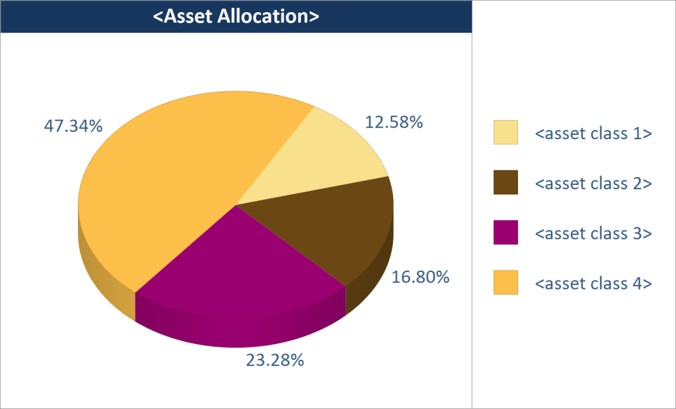
MA
17). Asset Allocation - Current Allocation (Chart)
Description: This object displays the overall asset allocation of the portfolio. The actual asset classes defined in your data will be displayed.
Settings:
Setting Name: Sort by
Type: dropdown
Values (for drop downs): default asset class order; asset class value, ascending; asset class value, descending
Default Value: default asset class order
Help Text:
Number Formatting
**Decimal places % in legend: Default for % - 2 decimals.
Notes:
** Chart title is an artifact from the sample I had. Should say “Asset Allocation”.

Slide 18
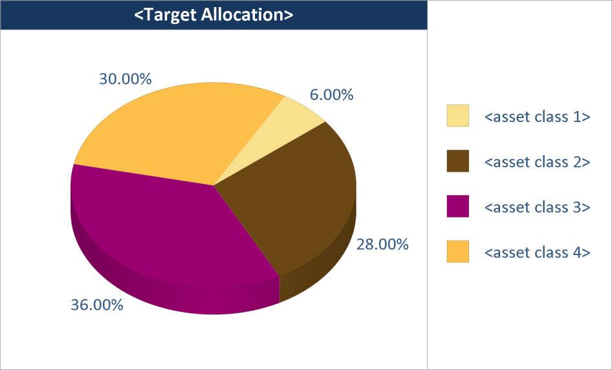
MA
18). Asset Allocation - Target Allocation (Chart)
Description: This object displays the target asset allocation of the portfolio. The actual asset classes defined in your data will be displayed. **Please note: You must send Target Allocation data for this object to work. If you send Target Allocation as a range, this object won’t display any data.
Settings:
Setting Name: Sort by
Type: dropdown
Values (for drop downs): default asset class order; asset class value, ascending; asset class value, descending
Default Value: default asset class order
Help Text:
Number Formatting
**Decimal places % in legend: Default for % - 2 decimals.
Notes:
**If target data is sent as a range, and this object is used, when generating can we display an error message in place of the object? Message would say: “Error: Target allocation data is sent as a range. In order for this object to display properly, the target for each asset class must be a numeric value. Either send data in proper format or do not use this object for this account.”

Slide 19
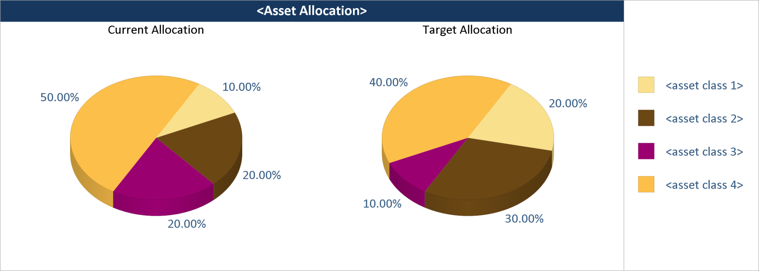
MA
19). Asset Allocation – Current and Target Allocation (Chart)
Description: This object displays the target allocation in comparison to the current allocation of the portfolio. **Please note: You must send Target Allocation data for this object to work. If you send Target Allocation as a range, this object won’t display any data.
Settings:
Setting Name: Sort by
Type: dropdown
Values (for drop downs): default asset class order; asset class value, ascending; asset class value, descending
Default Value: default asset class order
Help Text:
Number Formatting
**Decimal places % in legend: Default for % - 2 decimals.
Notes:
**If target data is sent as a range, and this object is used, when generating can we display an error message in place of the object? Message would say: “Error: Target allocation data is sent as a range. In order for this object to display properly, the target for each asset class must be a numeric value. Either send data in proper format or do not use this object for this account.”
**In Help for “Font settings”, need to say:
**Please note: the font type, size, color or style cannot be changed for the “Current Allocation” and Target Allocation” text.

Slide 20
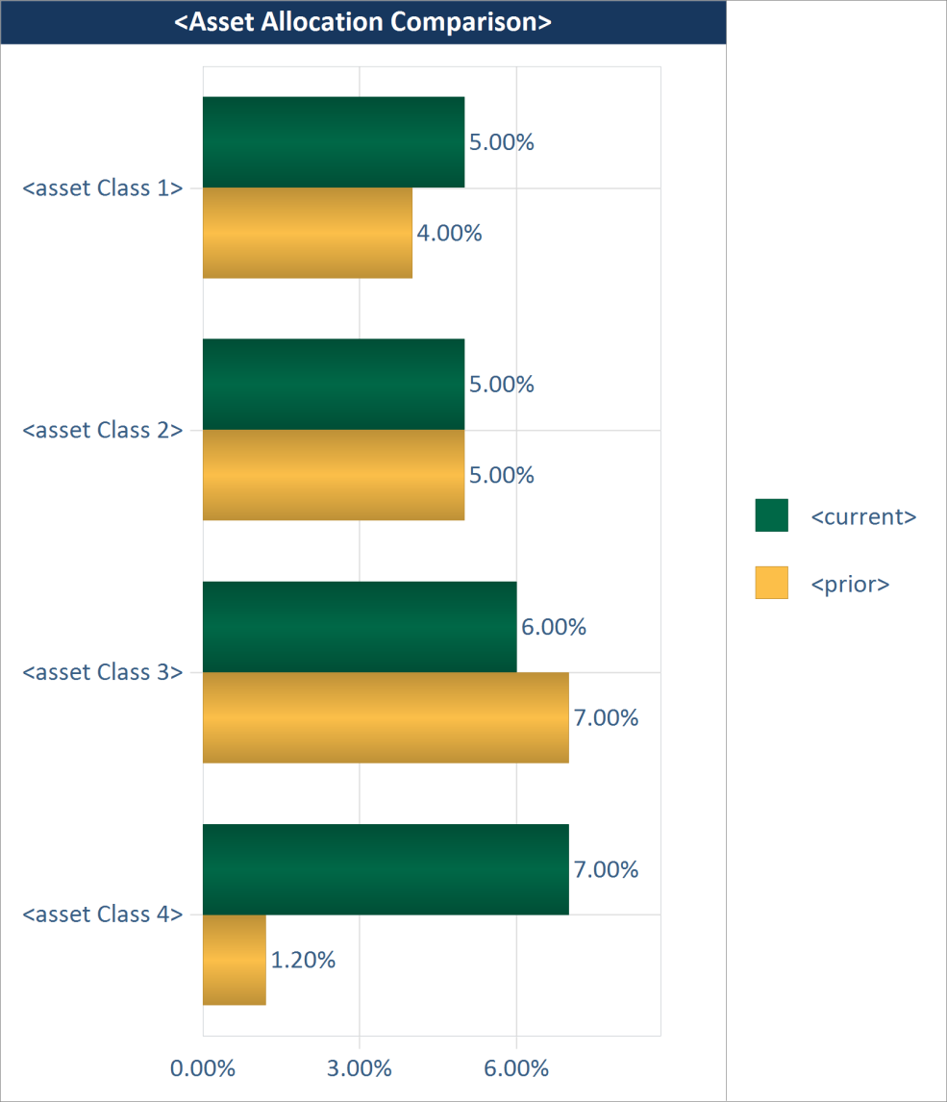
MA
20). Asset Allocation – Comparison with Prior Period (Chart)
Description: This object displays the current asset allocation of the portfolio along with the allocation for a prior period you select. The actual asset classes defined in your data will be displayed.
Settings:
Setting Name: Prior period
Type: dropdown
Values (for drop downs): prior month-end; prior quarter-end; prior year-end; 12 months ago; custom
Default Value: prior quarter-end
Help Text:
Need child setting with calendar control if “custom” is selected.
Setting Name: Sort by
Type: dropdown
Values (for drop downs): default asset class order; asset class value, ascending; asset class value, descending
Default Value: default asset class order
Help Text:
Number Formatting
**Decimal places on all columns: Default for MVs – zero decimals; Default for % - 2 decimals.
**currency formatting on currency fields
Notes:
**Custom NOT available in Easy.
**First period and bar on top is As of Date.
**Will need to identify the 2 colors for current Vs prior period
**One of the periods could have an asset class that wasn’t in the other period. If so, for the missing period, show $0 and 0%.

Slide 21
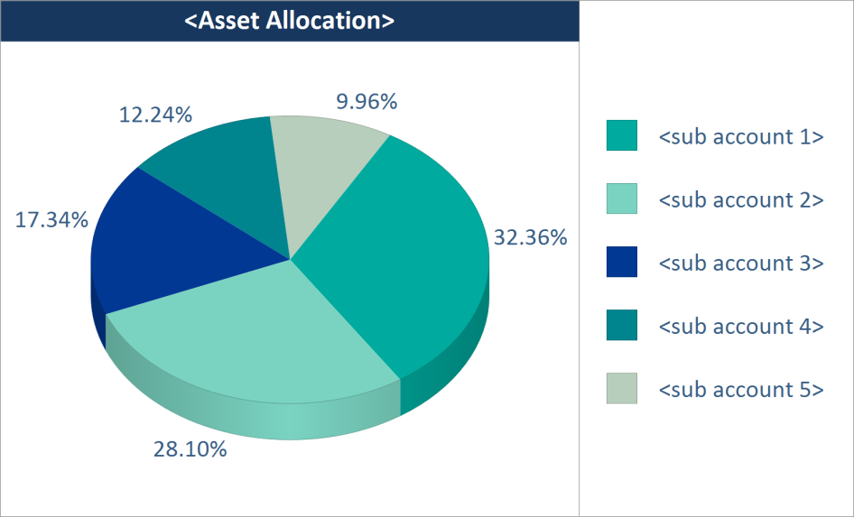
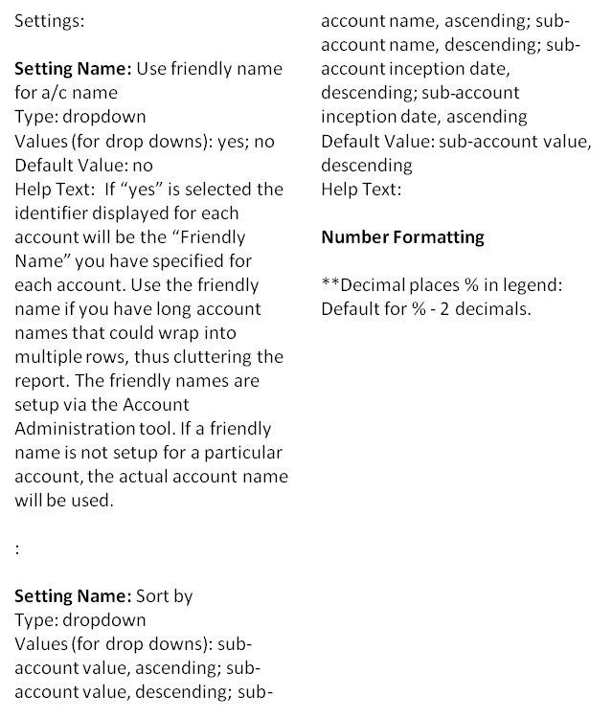
MA
21). Asset Allocation – [Group] Market Values by Sub_Account (Chart)
Description: This object displays the value of each sub-account in a relationship.

Slide 22
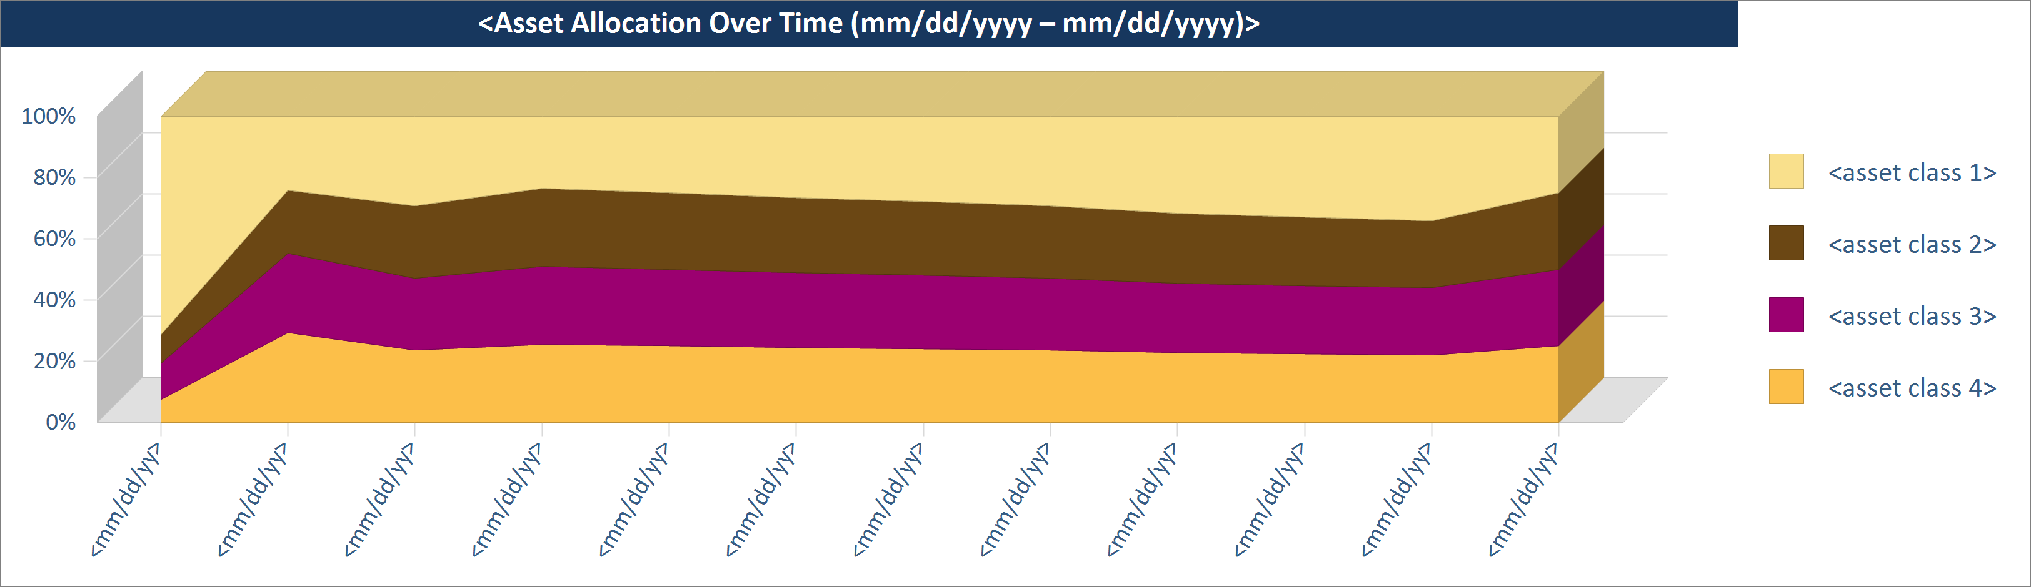
MA
22). Asset Allocation – Asset Allocation Over Time (Chart)
Description: This object displays the composition of the portfolio at the asset class level over a selected period. The actual asset classes defined in your data will be displayed.
Settings:
Setting Name: Time period
Type: dropdown
Values (for drop downs): year to date; 1 year trailing; 2 years trailing; 3 years trailing; 4 years trailing; 5 years trailing; 7 years trailing; 10 years trailing; since inception; custom
Default Value: since inception
Help Text: This setting determines the time period displayed on the X-axis. If an option other than “since inception” is selected and the account inception date is after the start of the selected period, then “since inception” will be used as the start of the time period until the selected start date occurs after the inception date.
Need child setting with calendar control if “custom” is selected.
Setting Name: X-axis interval
Type: dropdown
Values (for drop downs): month; quarter; year; default
Default Value: default
Help Text: This setting determines if monthly, quarterly or yearly intervals are displayed on the X axis for time period selected. Selecting “default” will automatically determine the interval as follows – if start of selected time frame is < 1 yr from the reporting date, then months; if between 1 – 3 yrs, then quarters; if > 3 yrs, then years.
Setting Name: Sort by
Type: dropdown
Values (for drop downs): default asset class order; asset class value, ascending; asset class value, descending
Default Value: default asset class order
Help Text: Market Value based sorting is base on the values as of the reporting date.
Number Formatting
**Decimal places on all columns: Default for MVs – zero decimals; Default for % - 2 decimals.
**currency formatting on currency fields
Notes:
**Custom NOT available in Easy.
**Sort order – top to bottom of the stack; any MV related sorts are based off the As of Date.
** If inception date falls mid-period in the first period(x interval), need asterisk on the first period and a footnote saying: Since inception (mm/dd/yyyy). Remember, date format is sensitive to the DisplayDateFormat config. Parameter.
**What if the As of Date is a mid way in the Interval? Can we display mm/dd/yyyy then? Rule would be – if As of Date = end of interval, then display interval; else, display date??

Slide 23
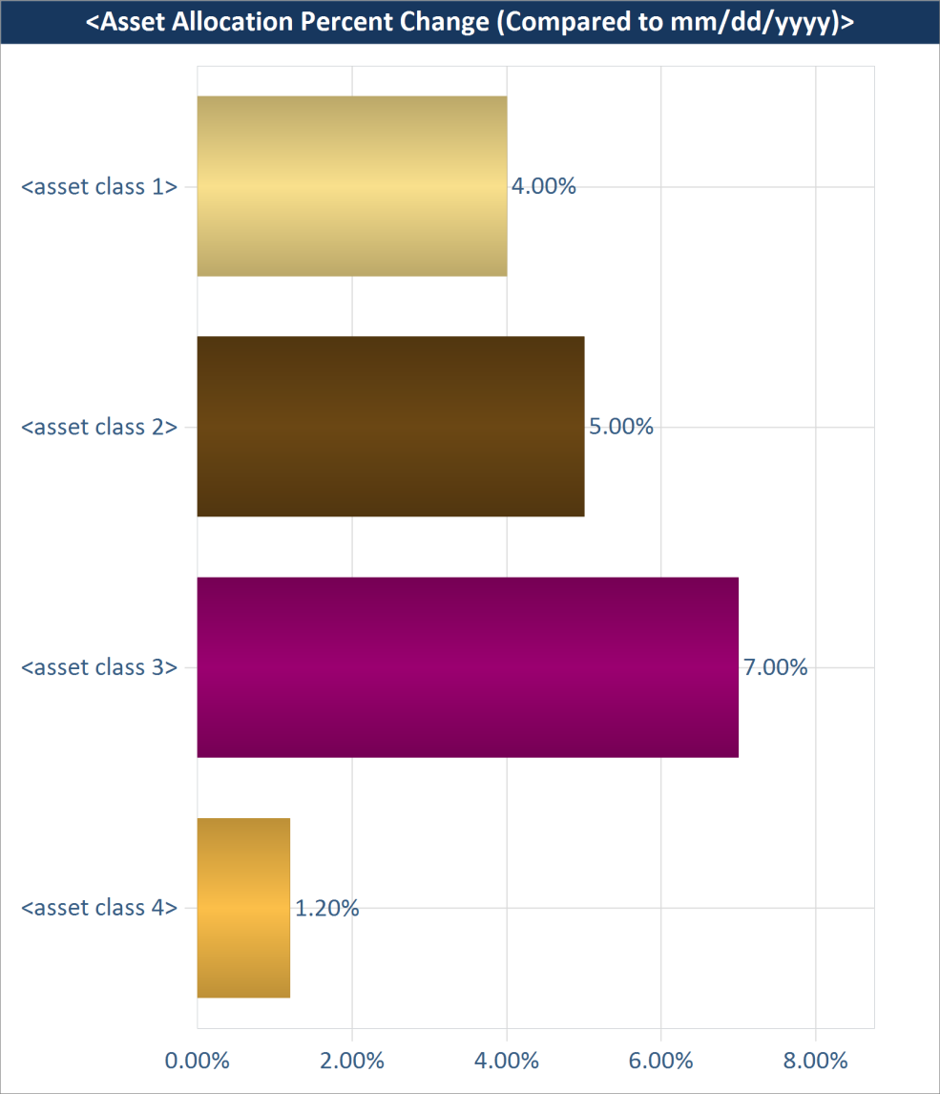
MA
23). Asset Allocation – % Change Compared to Prior Period (Chart)
Description: This object displays the percent change between the current asset allocation and the allocation for a prior period you select. The actual asset classes defined in your data will be displayed.
Settings:
Setting Name: Prior period
Type: dropdown
Values (for drop downs): prior month-end; prior quarter-end; prior year-end; 12 months ago; custom
Default Value: prior quarter-end
Help Text:
Need child setting with calendar control if “custom” is selected.
Setting Name: Sort by
Type: dropdown
Values (for drop downs): default asset class order; asset class value, ascending; asset class value, descending
Default Value: default asset class order
Help Text:
Number Formatting
**Decimal places: Default for % - 2 decimals.
Notes:
**Custom NOT available in Easy.
**First period and bar on top is As of Date; 2nd bar shows the % change compared to prior period.
**Right-side legend will say: “Change Compared to mm/dd/yyyy”
**Will need to identify the 2 colors for current Vs % change

Slide 24
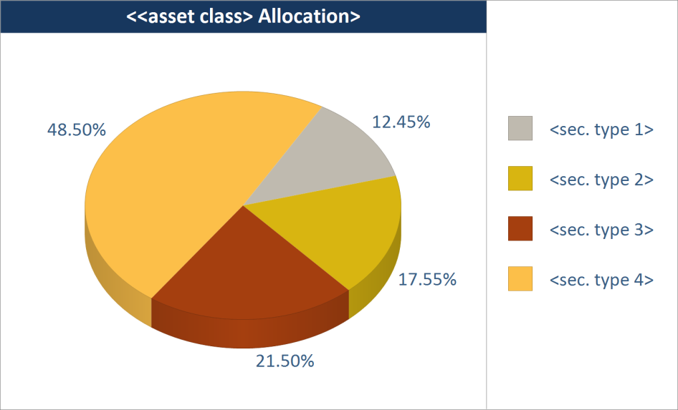
MA
24). Asset Allocation - One Asset Class by Subcategory (Chart)
Description: This object displays the overall allocation of a asset class by subcategory (sector, industry or security type). The subcategory for each asset class is specified during system setup.
Settings:
Setting Name: Asset class
Type: dropdown
Values (for drop downs): {list of asset classes}
Default Value: {first in list}
Help Text:
Setting Name: Roll-up as “Other” subcategory
Type: dropdown
Values (for drop downs): none; all subcategories except top N; all subcategories less than N%
Default Value: none
Help Text: This setting lets you roll-up certain subcategories into a “Other” subcategory. Select “none” to show all subcategories individually. Select “all subcategories except top N” and enter a whole number for N to show only a certain number of subcategories and roll-up the rest into a “Other” subcategory. Select “all subcategories less than N%” and enter a percentage (i.e. 5) for N to roll-up all subcategories below this percentage as “Other”. **Please note: Do NOT enter the percent sign after the number.
  Setting Name: Top N / N%
  Type: entry box
  Default Value: blank
**Child setting if value other than “none” is selected.
Setting Name: Sort by
Type: dropdown
Values (for drop downs): default security type order; security type value, ascending; security type value, descending
Default Value: default security type order
Help Text:
Setting Name: Subcategory
Value: “Click here for help”
Help Text: The subcategory to display within each asset class has been set during system implementation time. If there is an asset class with no subcategory, then individual securities in this asset class are displayed. If you want to change the subcategory associated with an asset class, please contact your systems administrator or Assette Client Service at ClientService@assette.com.
Number Formatting
**Decimal places on all columns: Default for MVs – zero decimals; Default for % - 2 decimals.
**currency formatting on currency fields
Notes:
**In Roll-up setting:
a). If a decimal is entered for Top N, round to the nearest whole #. (i.e. .5 will become 1; 6.5 will become 7 and so on).
b). If a % is entered for N%, can we ignore this – use only the number portion?
Sorting should be top to bottom in legend

Slide 25
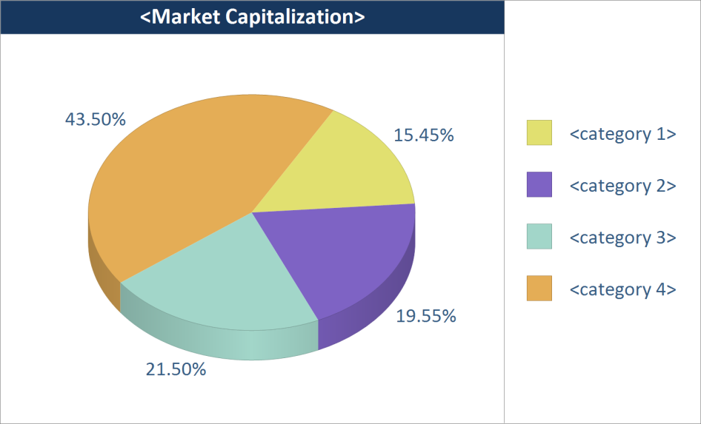
MA
25). Asset Allocation – Allocation by Market Cap (Chart)
Description: This object displays the overall allocation by market capitalization. **Please note: Your data needs to contain market capitalization categories for each security in order for this object display properly.
Settings:
Setting Name: Sort by
Type: dropdown
Values (for drop downs): market cap value, ascending; market cap value, descending
Default Value: market cap value, descending
Help Text:
Number Formatting
**Decimal places on all columns: Default for MVs – zero decimals; Default for % - 2 decimals.
**currency formatting on currency fields
Notes:
**Need to decide on business tables that will house the market cap category – see Weaver.
Sorting should be top to bottom in legend

Slide 26
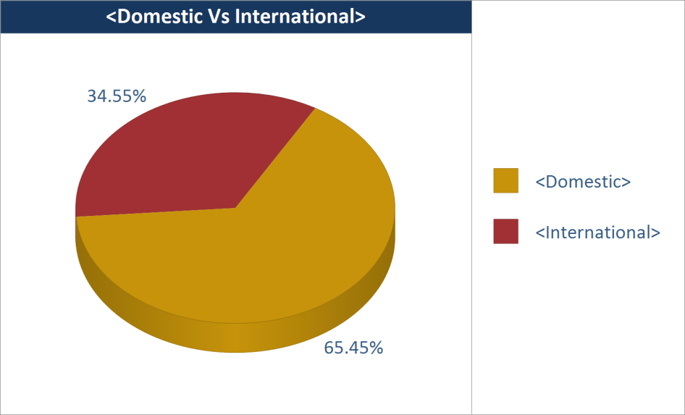
MA
26). Asset Allocation – Allocation by Domestic Vs International (Chart)
Description: This object displays the overall allocation by domestic Vs international. **Please note: Your data needs to contain domestic Vs international categorization at the security level.
Settings:
Number Formatting
**Decimal places on all columns: Default for MVs – zero decimals; Default for % - 2 decimals.
**currency formatting on currency fields
Notes:
**Sort: domestic then international
**Need to decide on business tables. Can we use country code or separate categorization. If separate, will DP transform based on rule and populate categorization. If rule: CountryCode=US (Domestic) CountryCode= anything else (International)? See Weaver. What about master that displays the descriptions? May need VA UI.

Slide 27
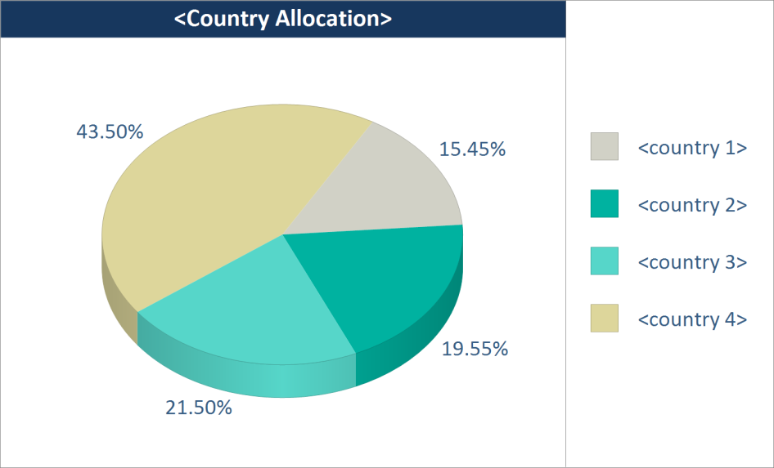
MA
27). Asset Allocation – Country Allocation Pie Chart (Chart)
Description: This object displays the country allocation of the portfolio. **Please note: Your securities need to be coded by country in order for this object to display data.
Settings:
Setting Name: Show cash
Type: dropdown
Values (for drop downs): yes; no
Default Value: yes
Help Text:
Setting Name: Sort by
Type: dropdown
Values (for drop downs): default country order; country value, ascending; country value, descending
Default Value: default country order
Help Text:
Number Formatting
**Decimal places on all columns: Default for MVs – zero decimals; Default for % - 2 decimals.
**currency formatting on currency fields
Notes:
**Cash is always shown last.
Sorting should be top to bottom in legend

Slide 28
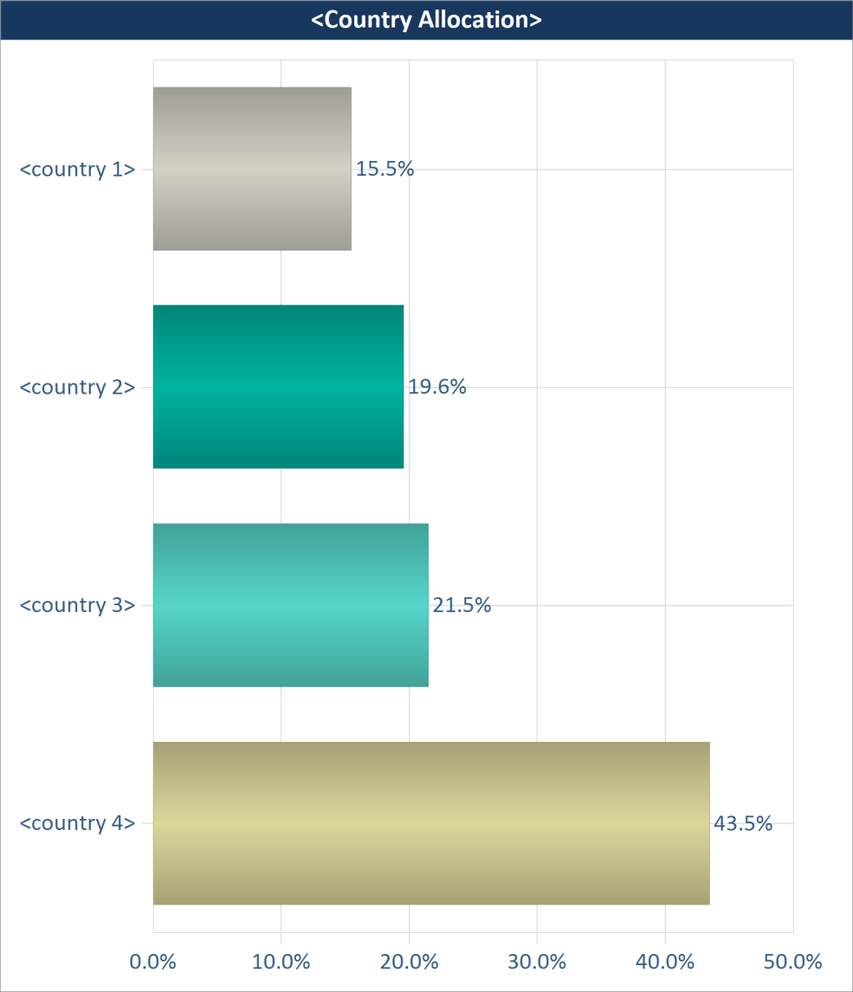
MA
28). Asset Allocation – Country Allocation Bar Chart (Chart)
Description: This object displays the country allocation of the portfolio. **Please note: Your securities need to be coded by country in order for this object to display data.
Settings:
Setting Name: Show cash
Type: dropdown
Values (for drop downs): yes; no
Default Value: yes
Help Text: If you do not show cash, the Percent of Portfolio may not add up to 100%.
Setting Name: Sort by
Type: dropdown
Values (for drop downs): default country order; country value, ascending; country value, descending
Default Value: default asset class order
Help Text:
Number Formatting
**Decimal places on all columns: Default for MVs – zero decimals; Default for % - 2 decimals.
**currency formatting on currency fields
Notes:
**Cash is always shown last.
Sorting should be top to bottom in legend
2 decimals is the default. Change shell as well.

Slide 29
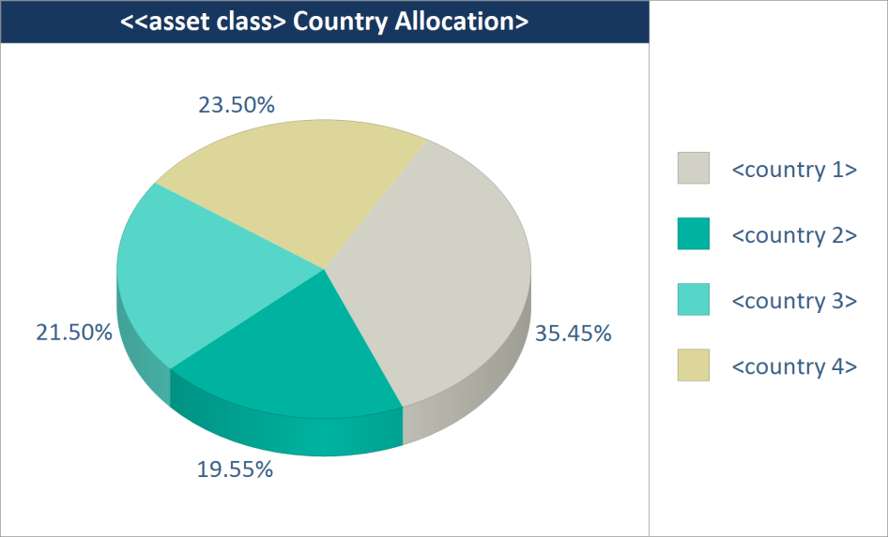
MA
29). Asset Allocation - One Asset Class by Country (Chart)
Description: This object displays the overall allocation of a asset class by country. The countries defined in your data will be displayed.
Settings:
Setting Name: Asset class
Type: dropdown
Values (for drop downs): {list of asset classes}
Default Value: {first in list}
Help Text:
Setting Name: Sort by
Type: dropdown
Values (for drop downs): default country order; country value, ascending; country value, descending
Default Value: default country order
Help Text:
Number Formatting
**Decimal places on all columns: Default for MVs – zero decimals; Default for % - 2 decimals.
**currency formatting on currency fields
Notes:
Sorting should be top to bottom in legend

Slide 30
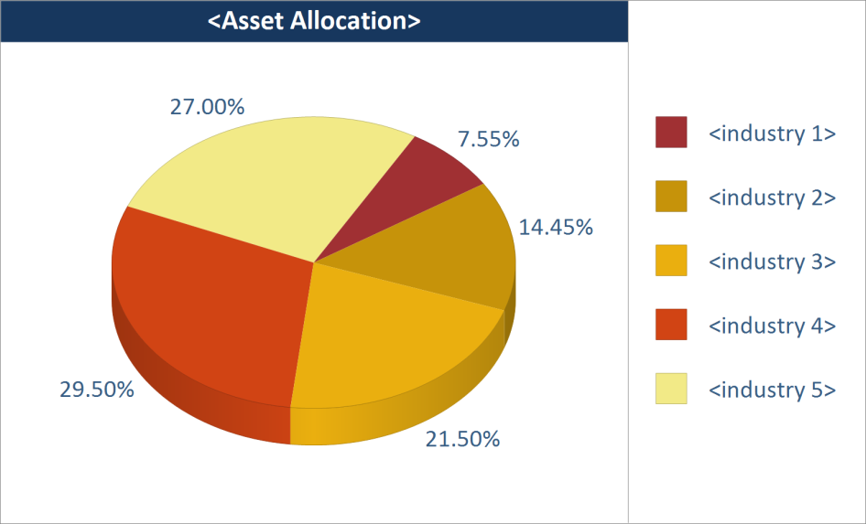
MA
30). Asset Allocation – Allocation by Industry/Subsector (Chart)
Description: This object displays the allocation of the portfolio by industry/subsector. The actual codes defined in your data will be displayed. This object is typically used by clients who use industry coding (or subsector in Schwab PortfolioCenter) to define asset classes.
Settings:
Setting Name: Show cash
Type: dropdown
Values (for drop downs): yes; no
Default Value: no
Help Text:
Setting Name: Include unsupervised assets
Type: dropdown
Values (for drop downs): yes; no
Default Value: no
Help Text: If “yes” is selected, then any unsupervised assets will be included in the respective asset classes that are displayed. **Please note: if you maintain a separate asset class for unsupervised assets, then this setting has no impact on including/excluding that asset class – the asset class will be displayed as a regular asset class.
Setting Name: Sort by
Type: dropdown
Values (for drop downs): default industry order; industry %, ascending; industry %, descending
Default Value: default industry order
Help Text:
Number Formatting
**Decimal places on all columns: Default for MVs – zero decimals; Default for % - 2 decimals.
**currency formatting on currency fields
Notes:
Cash is always last
Sorting should be top to bottom in legend

